Slide 1
18.404/6.840 Intro to the Theory of Computation
Instructor: Mike Sipser
Office Hours 4:00 – 5:30 Tuesdays
TAs: Office Hours TBD
- Fadi Atieh, Damian Barabonkov,
- Alex Dimitrakakis, Thomas Xiong,
- Abbas Zeitoun, and Emily Liu
Recitations start Friday
- Optional unless you need them!
- Hourly 10-2pm, online. On Sept 11, noon and 2pm → in-person
Homework, Exams, Quizzes
- See Course Information on homepage math.mit.edu/18.404
- First Pset due Sept 10. Posted on homepage

Slide 2
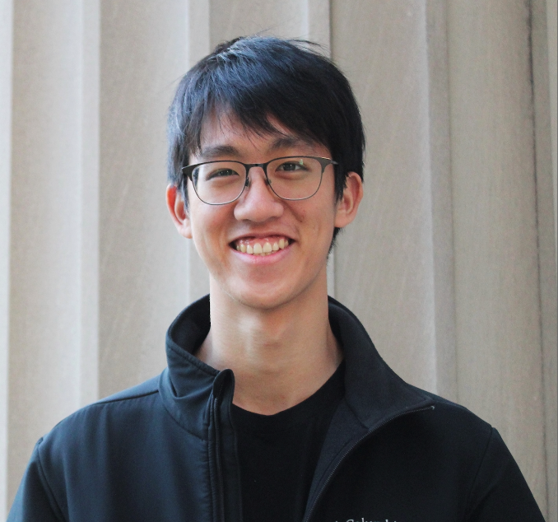





Our TAs
Thomas
Alex
Fadi
Abbas
Damian
Emily

Slide 3
18.404 Course Outline
Computability Theory 1930s – 1950s
What is computable… or not?
Examples:
program verification, mathematical truth
Models of Computation:
Finite automata, Turing machines, …
Complexity Theory 1960s – present
What is computable in practice?
Example: factoring problem
P versus NP problem
Measures of complexity: Time and Space
Models: Probabilistic and Interactive computation

Slide 4
Course Mechanics
Zoom Lectures
Live and Interactive via Chat
Live lectures are recorded for later viewing
Zoom Recitations starting this Friday
Not recorded; notes will be posted
Two convert to in-person on Sept 11
Review concepts and more examples
Optional unless you are having difficulty
Participation can raise low grades
Attend any recitation
Homework bi-weekly – 35%
More information to follow
Midterm (15%) and Final exam (25%)
Open book and notes
Check-in quizzes for credit – 25%
Distinct Live and Recorded versions
Complete either one for credit within 48 hours
Initially ungraded; full credit for participation
Check-in 1.1

Slide 5
Course Expectations
Prerequisites
Prior substantial experience and comfort with mathematical concepts, theorems, and proofs. Creativity will be needed for psets and exams.
Collaboration policy on homework
Allowed. But try problems yourself first.
Write up your own solutions.
No bibles or online materials.

Slide 6
Role of Theory in Computer Science
Applications
Basic Research
Connections to other fields
What is the nature of computation?

Slide 7






Let’s begin: Finite Automata
0
1
$$M1$$
0,1
1
$$q3$$
$$q1$$
$$q2$$
0
Input: finite string
Output: Accept or Reject
Computation process: Begin at start state,
read input symbols, follow corresponding transitions,
Accept if end with accept state, Reject if not.
Examples: 01101 → Accept
00101 → Reject
$M1$ accepts exactly those strings in $A$ where
$A = \{w| w$contains substring $11\}.$
States: $q1 q2 q3$
Transitions:
Start state:
Accept states:
1
Say that $A$ is the language of $M1$ and that $M1$ recognizes $A$ and that $A = L(M1)$.
Check-in 1.2

Slide 8











Finite Automata – Formal Definition
Defn: A finite automaton $M$ is a 5-tuple $(Q, Σ, δ, q0, F)$
$Q$ finite set of states
$Σ$ finite set of alphabet symbols
$δ$ transition function $δ: Q×Σ → Q$
$q0$ start state
$F$ set of accept states
Example:
$δ (q, a) = r$ means
$$q$$
a
$$r$$
0
$$M1$$
1
0,1
$$q1$$
$$q2$$
1
$$q3$$
0
$M1 = (Q, Σ, δ, q1, F)$
$Q = \{q1, q2, q3\}$
$Σ = \{0, 1\}$
$F = \{q3\}$
$$δ=$$
 | 0 | 1
$$q1$$ | $$q1$$ | $$q2$$
$$q2$$ | $$q1$$ | $$q3$$
$$q3$$ | $$q3$$ | $$q3$$
Notes:
Goal- Precise mathematical description

Slide 9


Finite Automata – Computation
Strings and languages
A string is a finite sequence of symbols in $Σ$
A language is a set of strings (finite or infinite)
The empty string ε is the string of length 0
The empty language $ø$ is the set with no strings
Defn: $M$ accepts string $w = w1w2 … wn$each $wi ε Σ$
if there is a sequence of states $r0, r1, r2, ,…, rn ε Q$
where:
- $r0 = q0$
- $ri = δ(r_{i−1}, wi)$ for $1≤i≤n$
- $rn ε F$
Recognizing languages
$L(M) = \{w| M accepts w\}$
$L(M)$is the language of $M$
$M$ recognizes $L(M)$
Defn: A language is regular if some
finite automaton recognizes it.

Slide 10

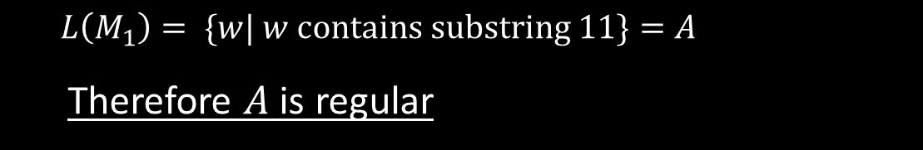




Regular Languages – Examples
$$M1$$
0
1
0,1
1
$$q3$$
$$q1$$
$$q2$$
0
More examples:
Let $B=\left\{w\right| w$has an even number of 1s$\}$
$B$ is regular (make automaton for practice).
Let $C=\left\{w\right| w$has equal numbers of 0s and 1s$\}$
$C$ is not regular (we will prove).
$L\left(M_{1}\right)= \{w| w contains substring 11\}=A$
Therefore $A$ is regular
Goal: Understand the regular languages

Slide 11


Regular Expressions
Regular operations. Let $A,B$ be languages:
Union: $A∪B=\left\{w\right| w∈A$ or $w∈B\}$
Concatenation: $A∘B=\left\{xy\right| x∈A$ and $y∈B\}=AB$
Star: $A^{∗}=\left\{x_{1}… x_{k}\right|$each$x_{i}∈A$ for $k≥0\}$
Note: $ε∈A^{∗}$ always
Example. Let $A=\{$good, bad$\}$ and $B=\{$boy, girl$\}$.
$A∪B=${good, bad, boy, girl}
$A∘B=AB=$ {goodboy, goodgirl, badboy, badgirl}
$A^{∗}=$ {$ε$, good, bad, goodgood, goodbad, badgood,
badbad, goodgoodgood, goodgoodbad, … }
Regular expressions
Built from $Σ$, members $Σ, ∅,ε$ [Atomic]
By using $∪, ∘, ∗$ [Composite]
Examples:
${\left(0∪1\right)}^{∗}=Σ^{∗}$ gives all strings over $Σ$
$Σ^{∗}1$ gives all strings that end with 1
$Σ^{∗}11Σ^{∗}=$all strings that contain 11 $=L\left(M_{1}\right)$
Goal: Show finite automata equivalent to regular expressions

Slide 12




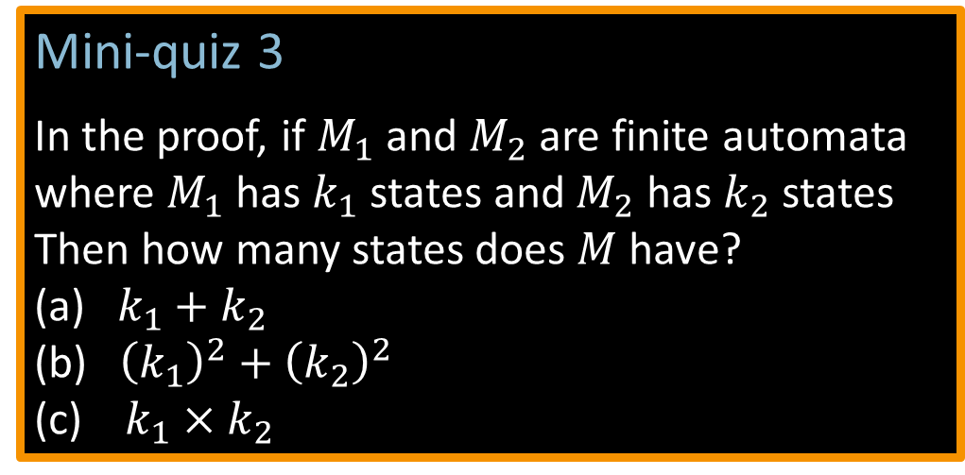




Closure Properties for Regular Languages
Theorem: If ${ A}_{1}, A_{2}$are regular languages, so is $A_{1}∪A_{2}$ (closure under $∪$)
Proof: Let $M_{1}=(Q_{1}, Σ, { δ}_{1}, { q}_{1}, { F}_{1})$ recognize $A_{1}$
$M_{2}=(Q_{2}, Σ, { δ}_{2}, { q}_{2}, { F}_{2})$ recognize $A_{2}$
Construct $M = (Q, Σ, δ, q0, F)$ recognizing ${A_{1}∪A}_{2}$
$M$ should accept input $w$ if either $M_{1}$ or $M_{2}$ accept $w$.
Mini-quiz 3
In the proof, if $M_{1}$ and $M_{2}$ are finite automata
where $M_{1}$ has $k_{1}$ states and $M_{2}$ has$k_{2}$ states
Then how many states does $M$have?
(a) $k_{1}+k_{2}$
(b) ${\left(k_{1}\right)}^{2}+{\left(k_{2}\right)}^{2}$
(c) $k_{1}×k_{2}$
Components of $M$:
$Q=Q_{1}×Q_{2}$
$=\left\{\left(q_{1},q_{2}\right)\right|q_{1}∈Q_{1}$ and $q_{2}∈Q_{2}\}$
$q_{0}=(q_{1}, q_{2})$
$δ\left(\left(q,r\right),a\right)=\left(δ_{1}\left(q,a\right),δ_{2}\left(r,a\right)\right)$
$F=F_{1}×F_{2}$
$F=\left(F_{1}×Q_{2}\right)∪\left(Q_{1}×F_{2}\right)$
$$M_{1}$$
$$q$$
$$M$$
?
$$q,r$$
$$M_{2}$$
NO! [gives intersection]
$$r$$
Check-in 1.3

Slide 13




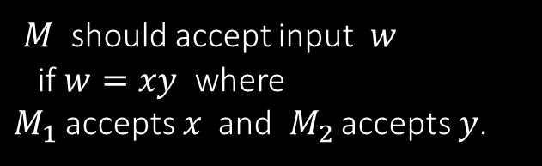





Closure Properties continued
Theorem: If ${ A}_{1}, A_{2}$are regular languages, so is $A_{1}A_{2}$ (closure under $∘$)
Proof: Let $M_{1}=(Q_{1}, Σ, { δ}_{1}, { q}_{1}, { F}_{1})$ recognize $A_{1}$
$M_{2}=(Q_{2}, Σ, { δ}_{2}, { q}_{2}, { F}_{2})$ recognize $A_{2}$
Construct $M = (Q, Σ, δ, q0, F)$ recognizing ${A_{1}A}_{2}$
$$M_{1}$$
$$M_{2}$$
$M$ should accept input $w$
if $w=xy$ where
$M_{1}$ accepts $x$ and $M_{2}$ accepts $y$.
$$M$$
$$w$$
$$x$$
$$y$$
Doesn’t work: Where to split $w$?

Slide 14

Quick review of today
Introduction, outline, mechanics, expectations
Finite Automata, formal definition, regular languages
Regular Operations and Regular Expressions
Proved: Class of regular languages is closed under $∪$
Started: Closure under $∘$ , to be continued…
Check-in 1.4

